Slide 1

Sequencing at a New Layer of Complexity
The Transcriptional Landscape of the Yeast Genome Defined by RNA sequencing
Presented by: Lumi

Slide 2
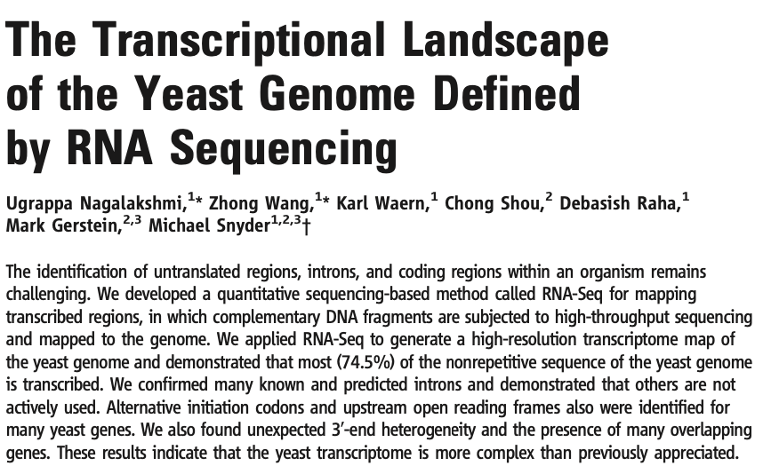
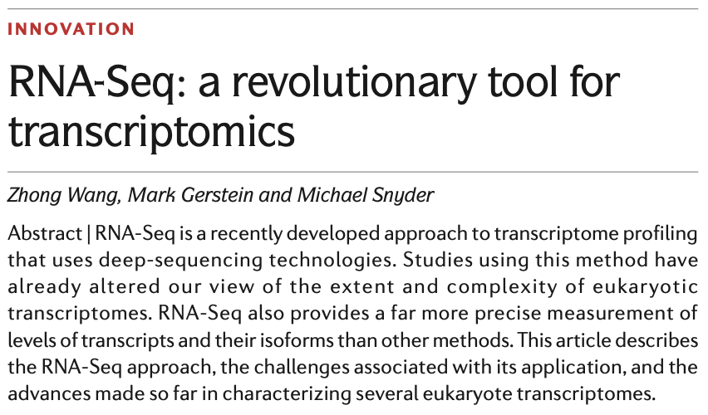
The Two Articles

Slide 3
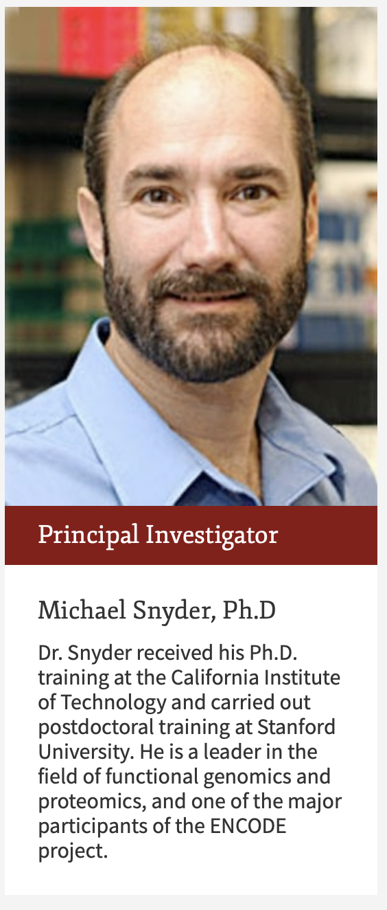
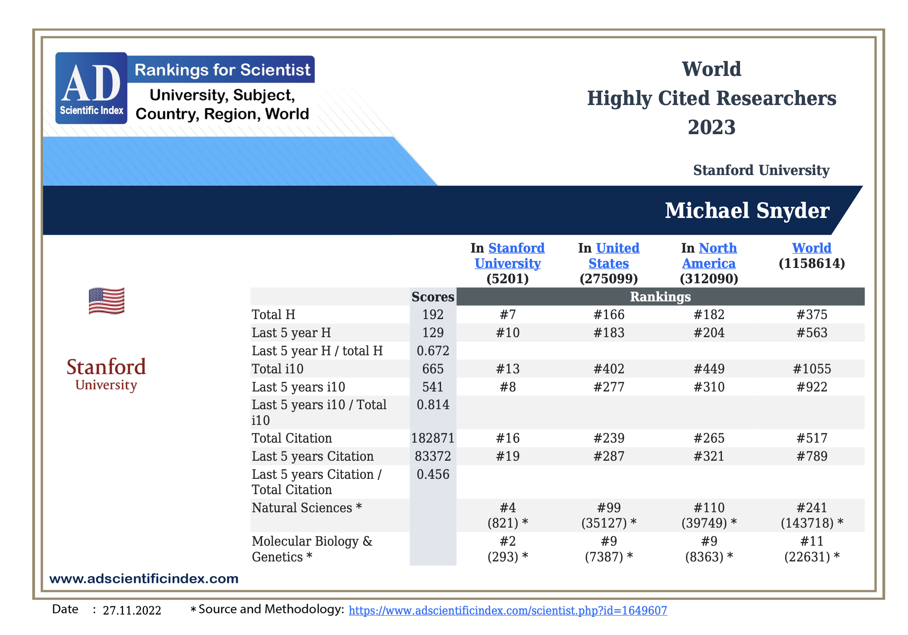
About the Research Group

Slide 4
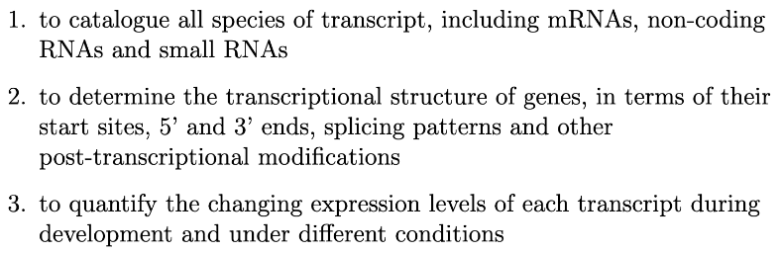
Transcriptomics

Slide 5
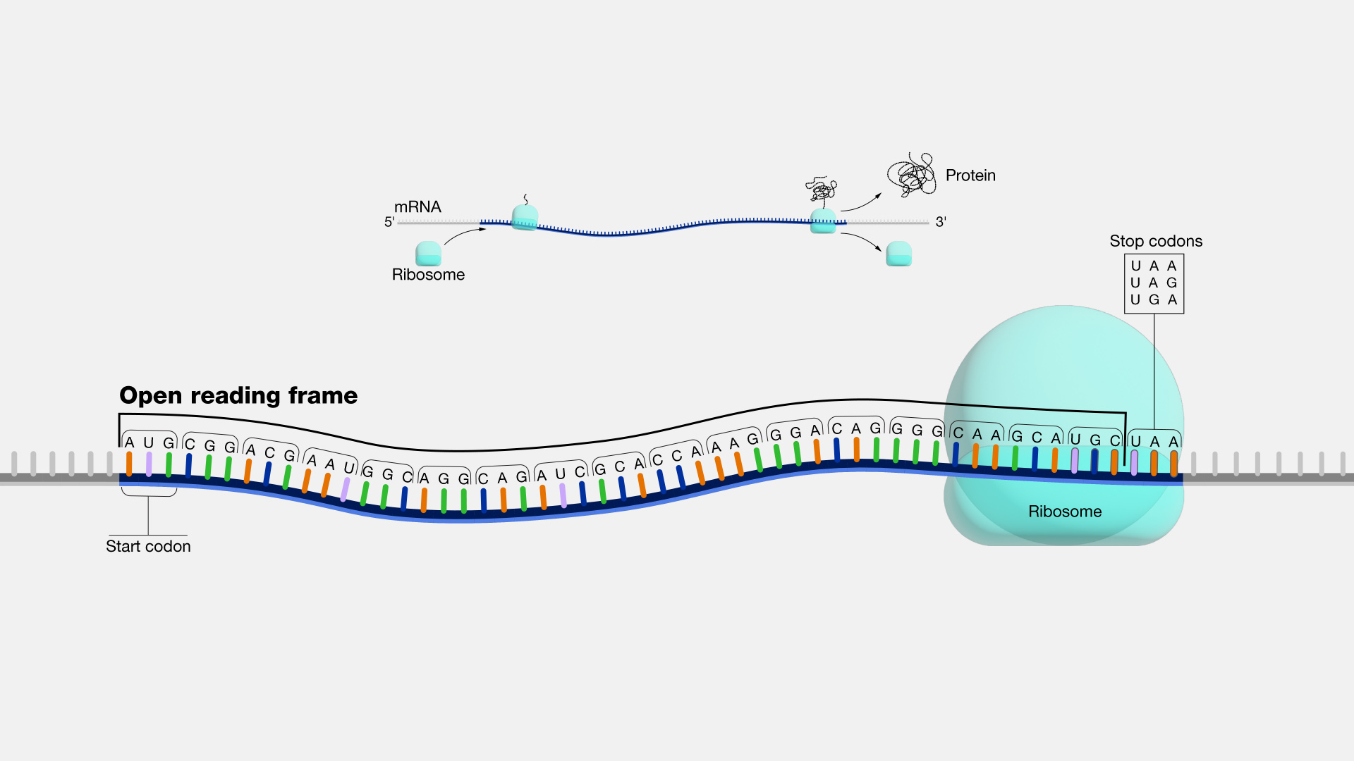
Before RNA-seq
Large open reading frames (ORFs)
Conservative regions across species
DNA microarrays
(Shchelochkov, 2022)

Slide 6
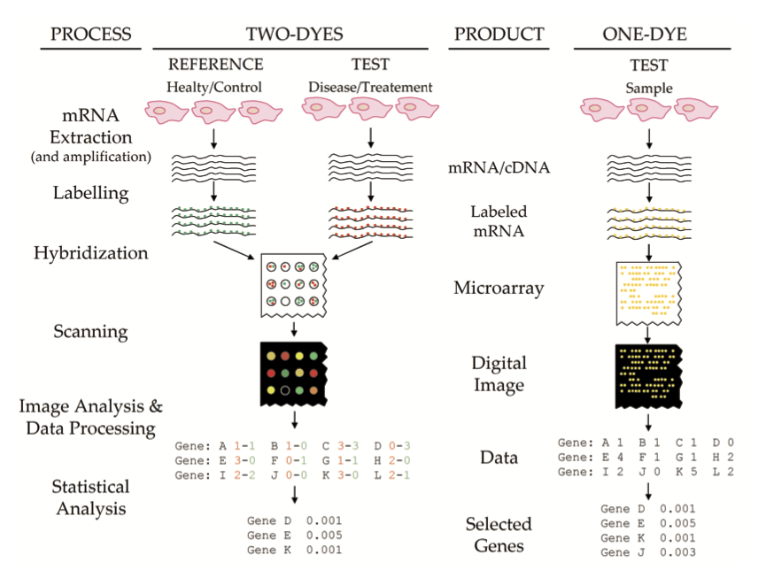
DNA microarrays
A very good video: https://www.youtube.com/watch?v=NgRfc6atXQ8

Slide 7
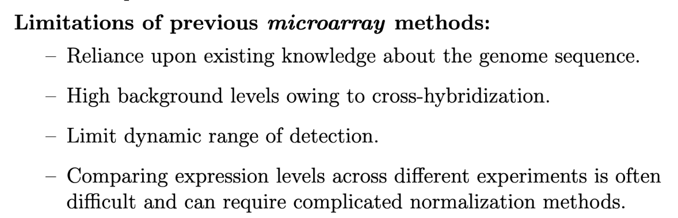
Problems with Previous Methods

Slide 8
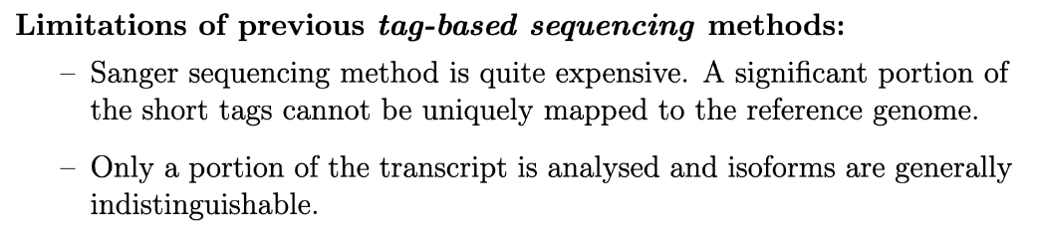
Problems with Previous Methods

Slide 9
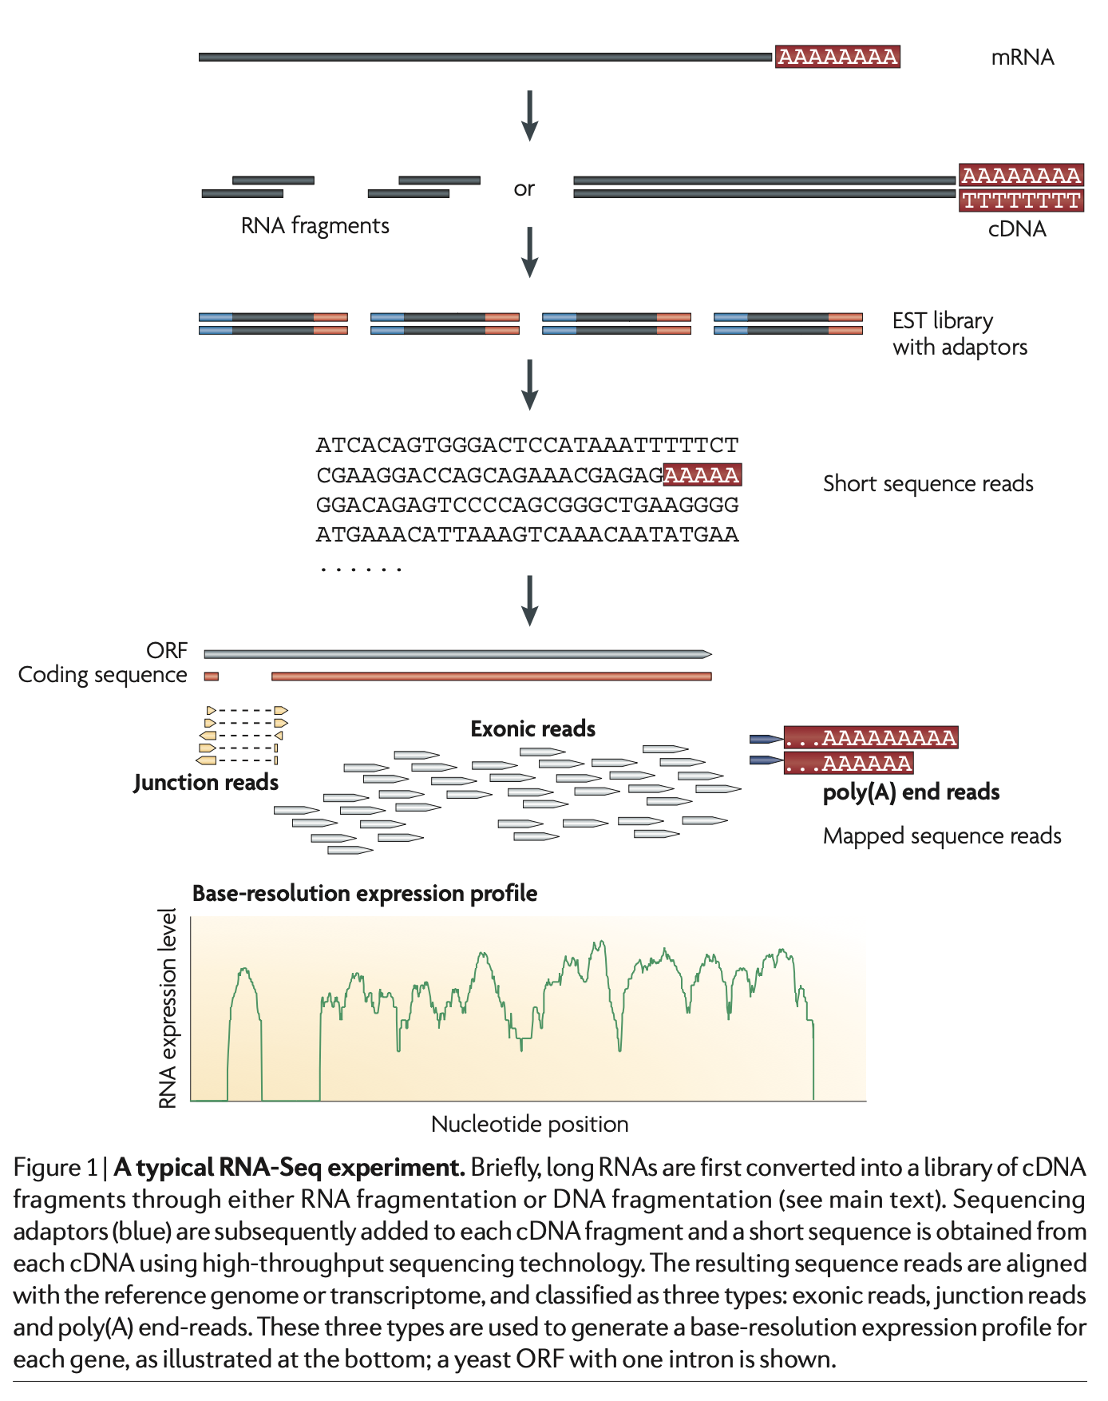
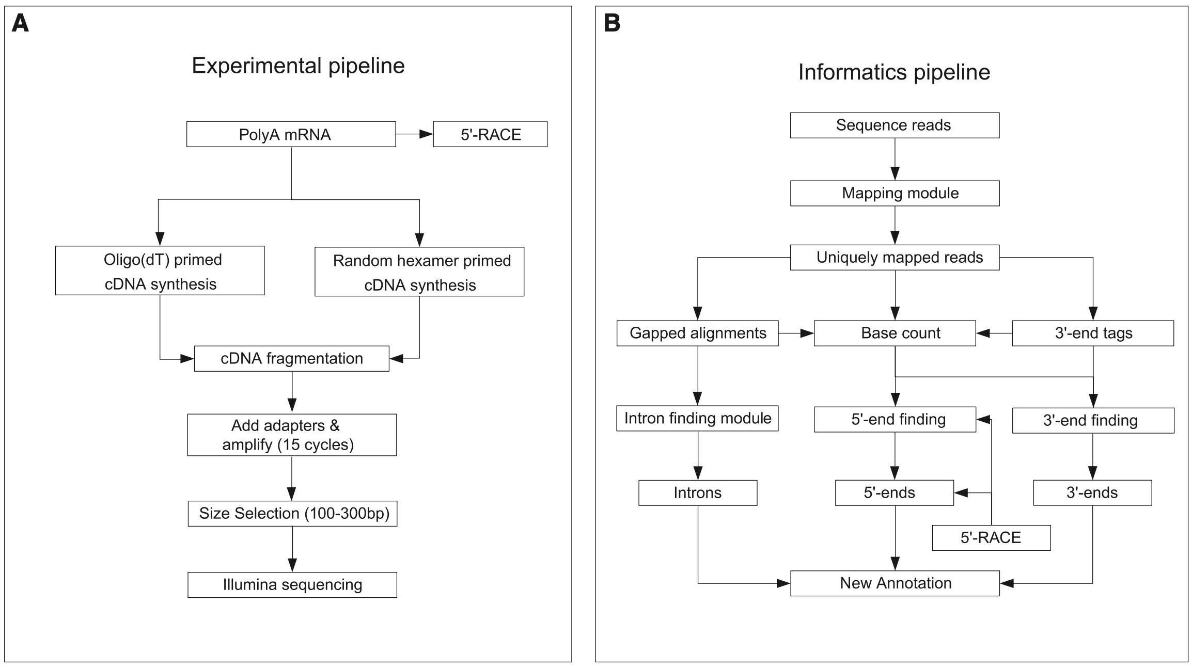
Workflow

Slide 10
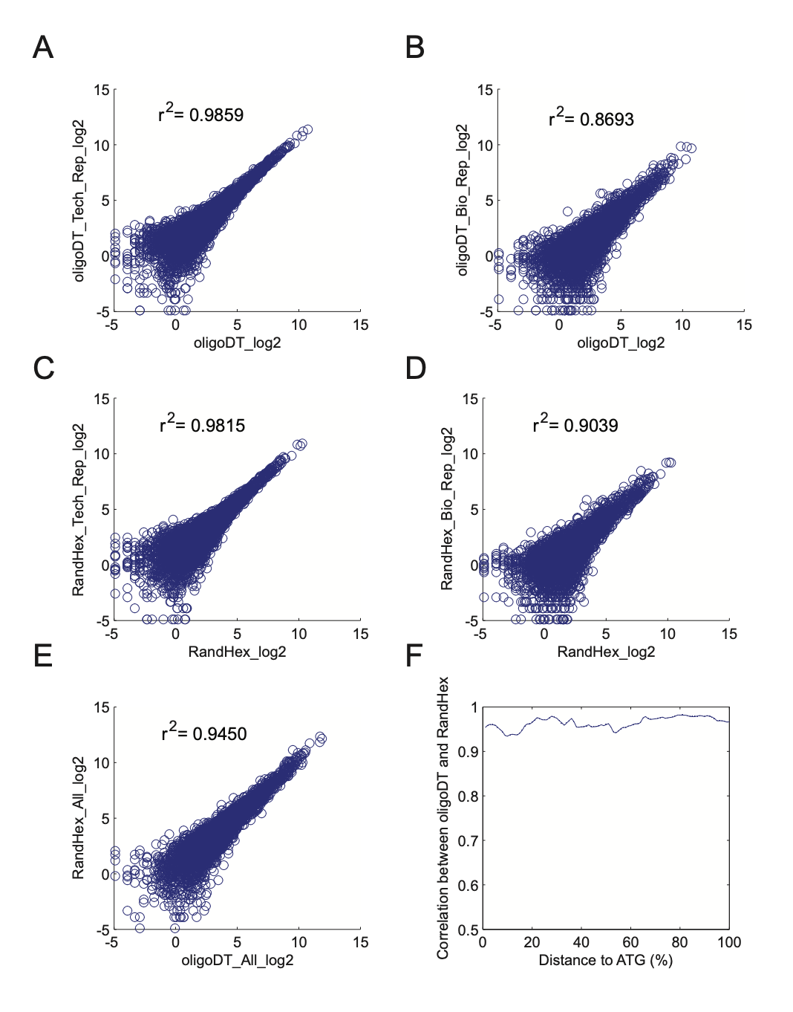
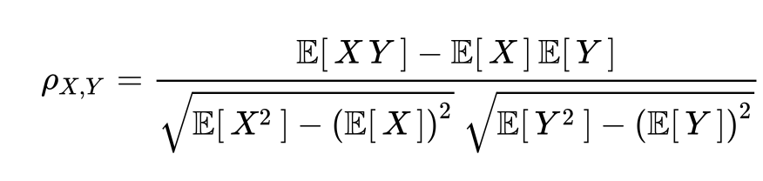
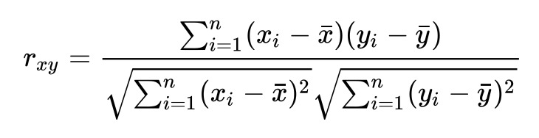
Analysis of Data - Merging Replicates
Pearson Correlation Coefficient for Population:
Pearson Correlation Coefficient for Sample:

Slide 11
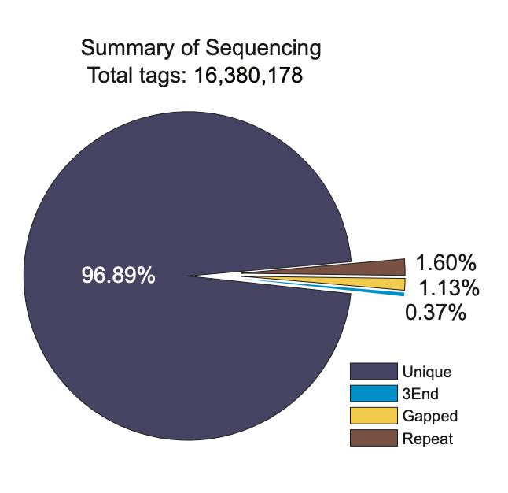
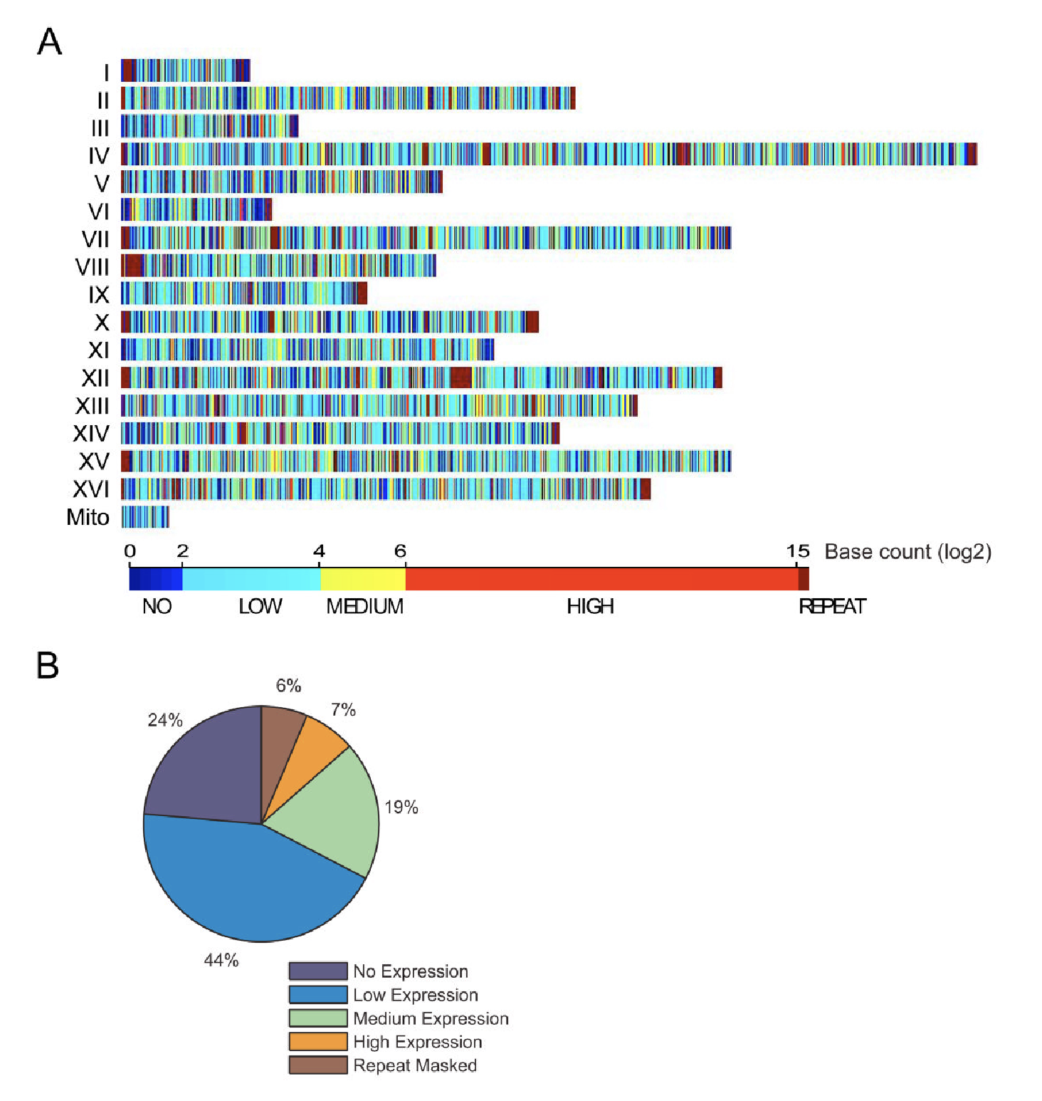
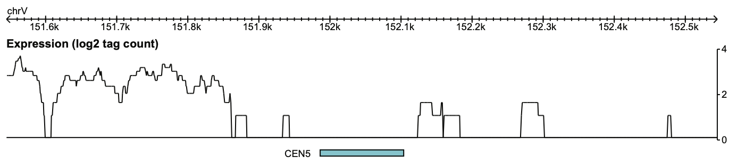
Analysis of Data - Sequence Mapping

Slide 12
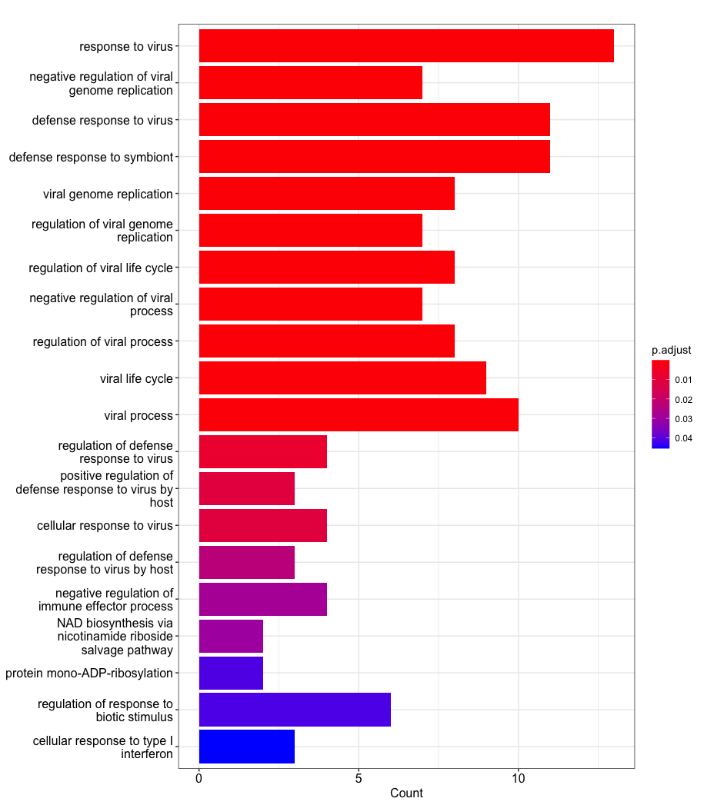
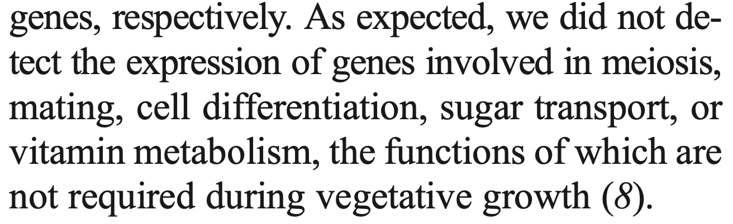
Gene Ontology
In null-hypothesis significance testing, the p-value is the probability of obtaining test results at least as extreme as the result actually observed, under the assumption that the null hypothesis is correct.

Slide 13
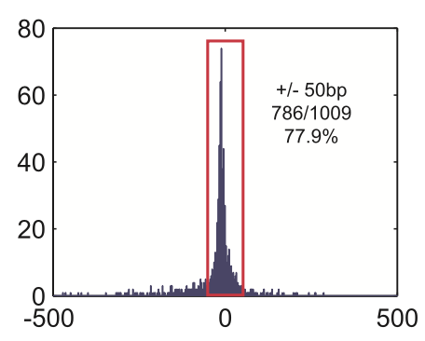
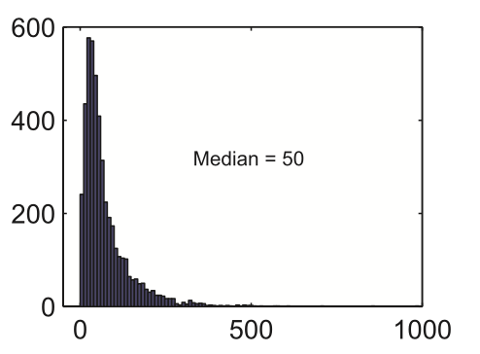
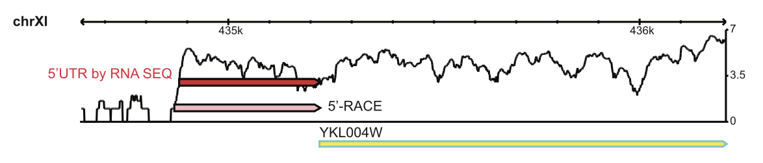
Determining 5’ and 3’ Untranslated Regions (UTRs)
RACE: An older version of RNA-seq using Sanger
sequencing.

Slide 14
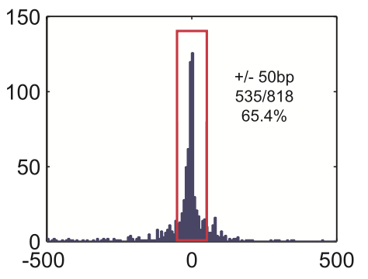
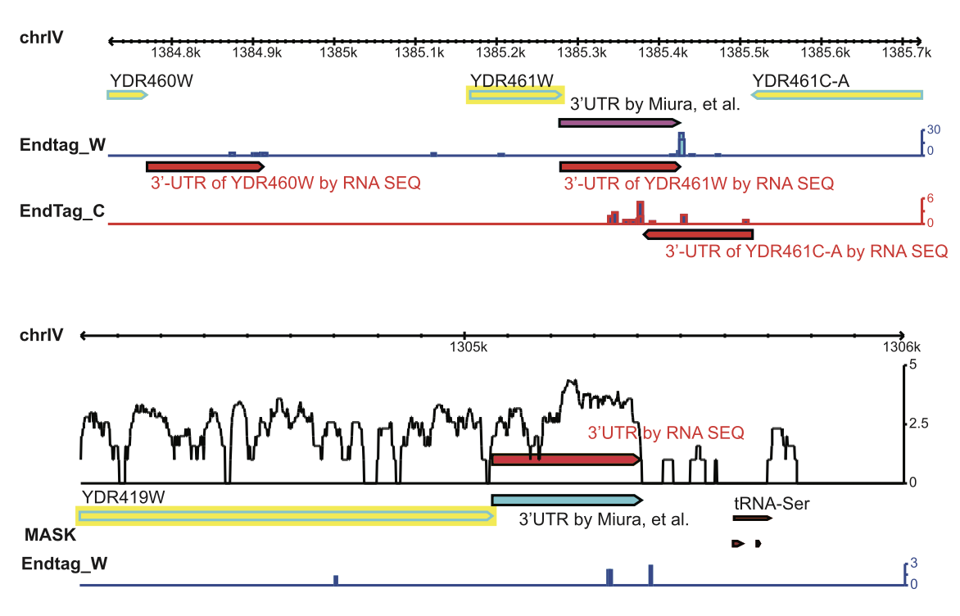
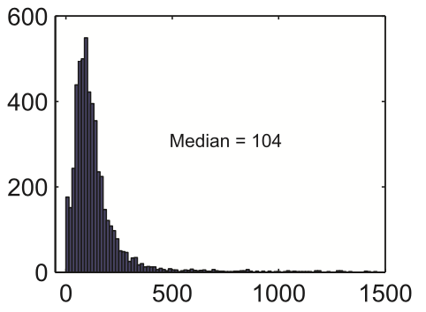
Determining 5’ and 3’ UTRs

Slide 15
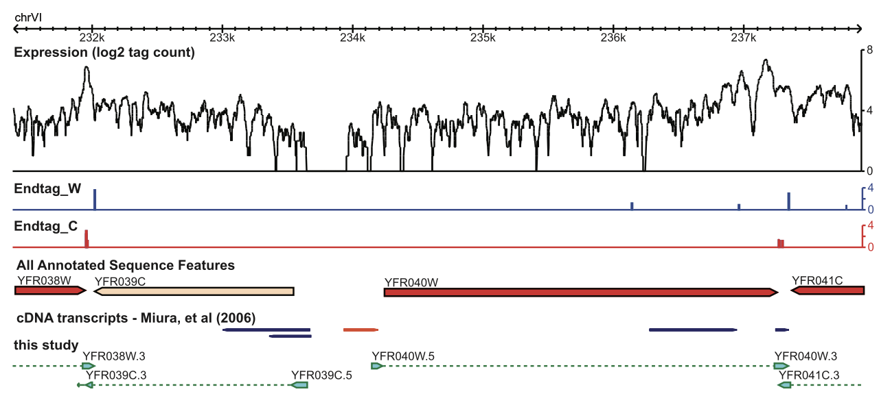
Determining 5’ and 3’ UTRs

Slide 16
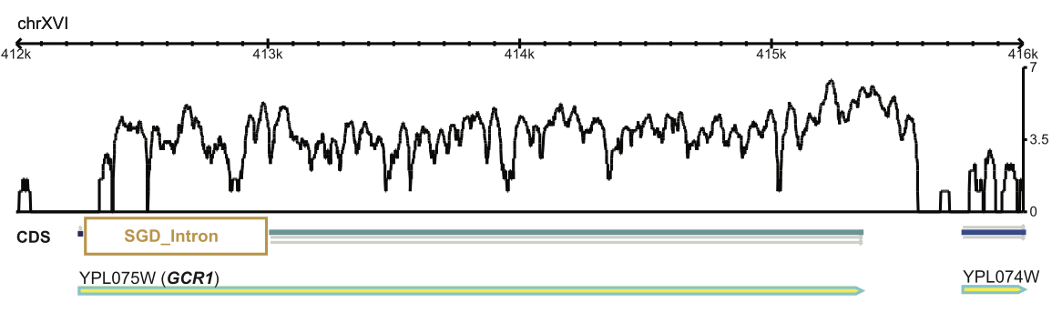
Determining Introns
Introns are previously defined by:
- sequence conservation
- microarray analyses
- other not-so-common methods

Slide 17
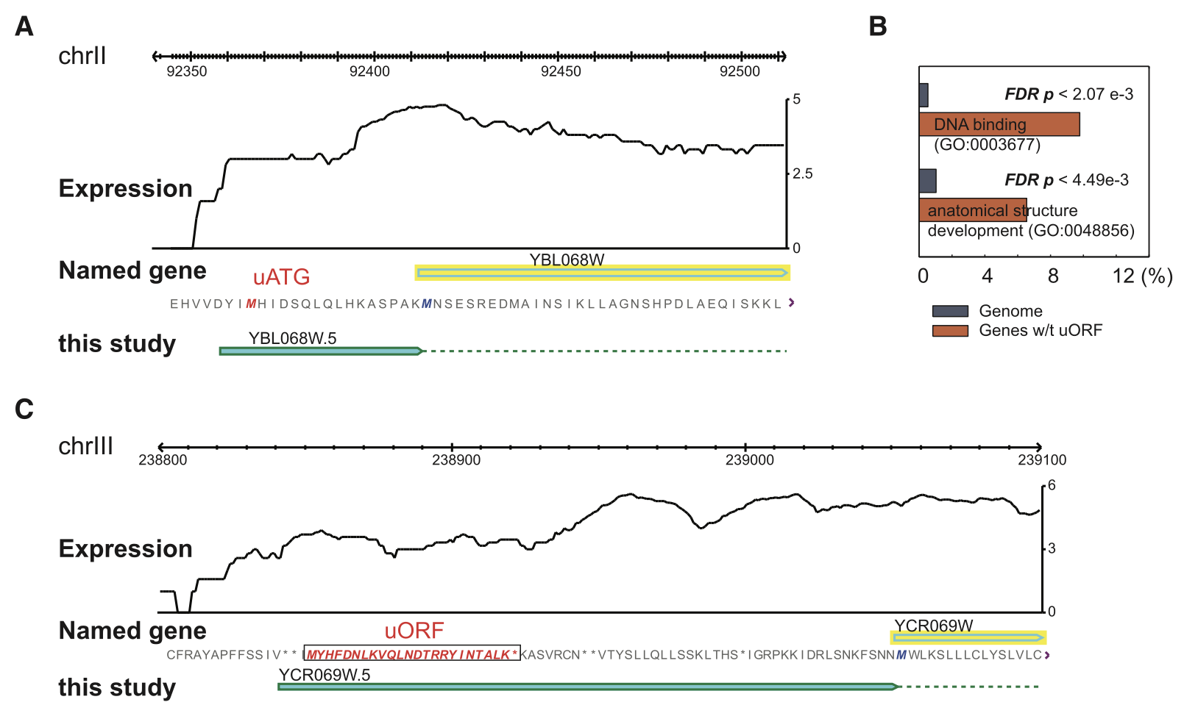
Prediction of Upstream ORFs (uORFs)
uORFs are shown to regulate protein expressio and mRNA degradation.

Slide 18
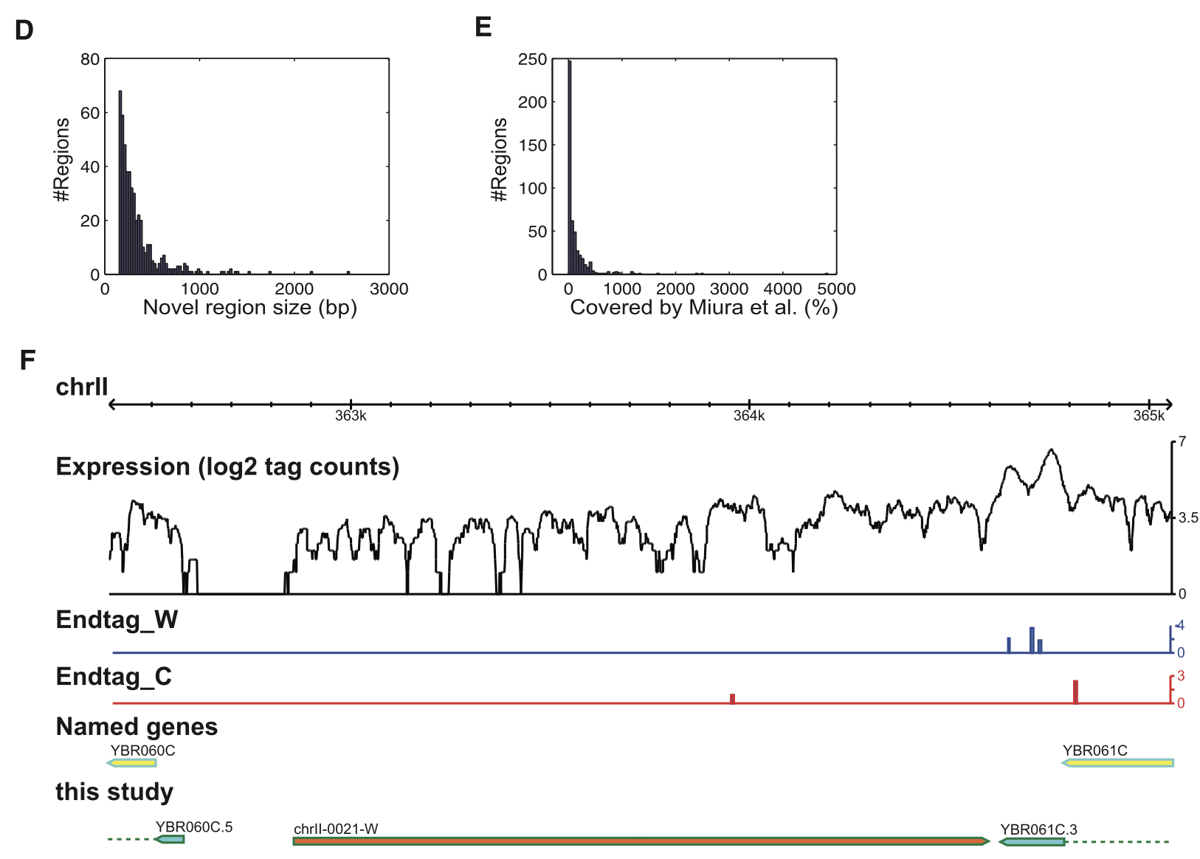
Discovery of New Intergenic Regions

Slide 19
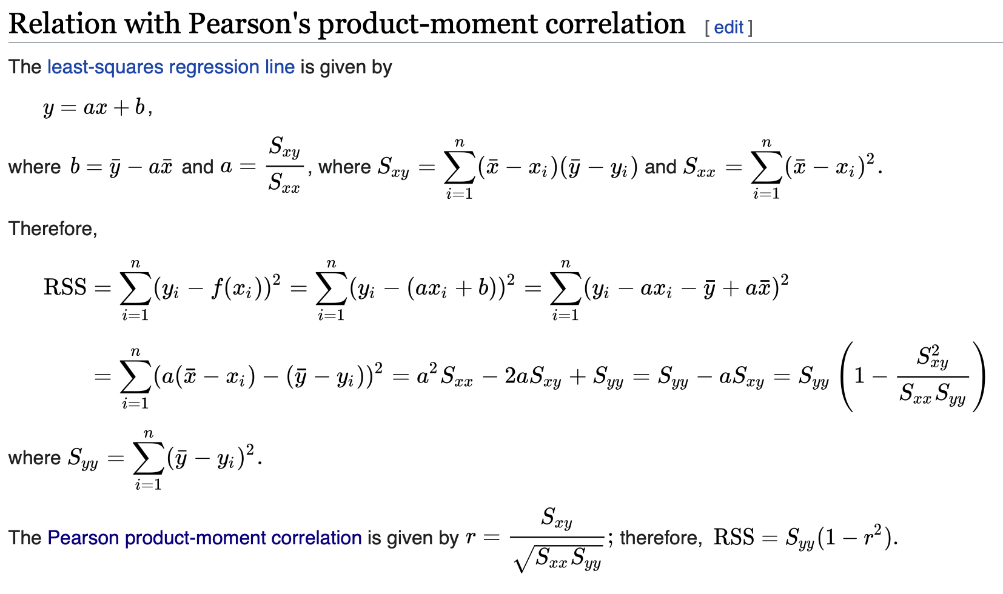
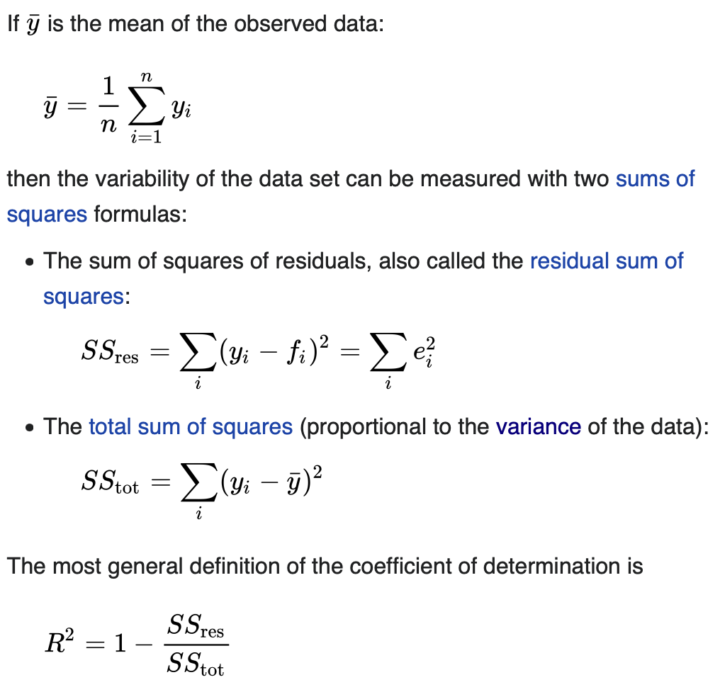
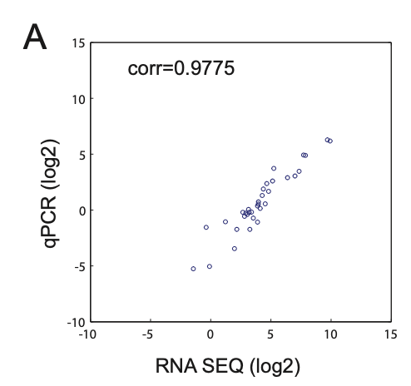
RNA-seq as a Quantitative Method
qPCR: PCR with fluoresent dye and fluorometer.

Slide 20
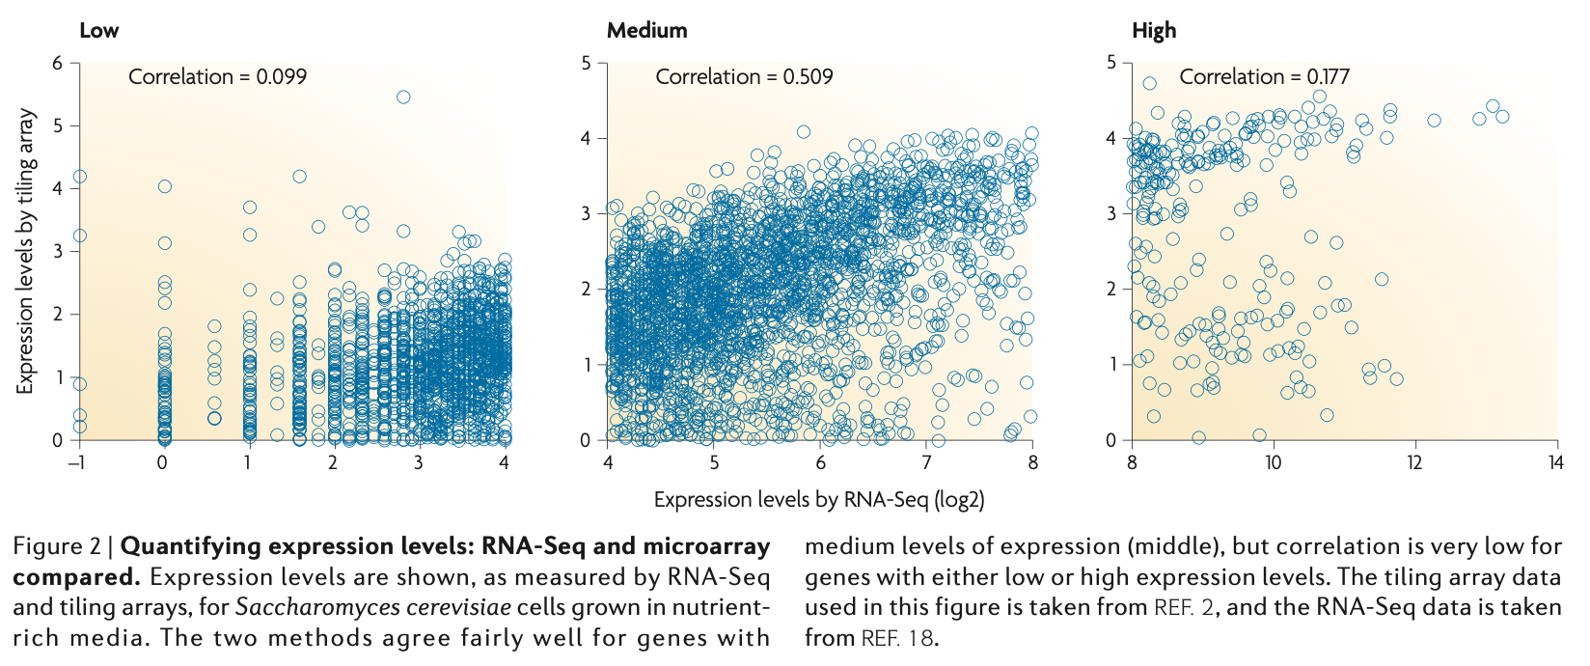
RNA-seq as a Quantitative Method

Slide 21
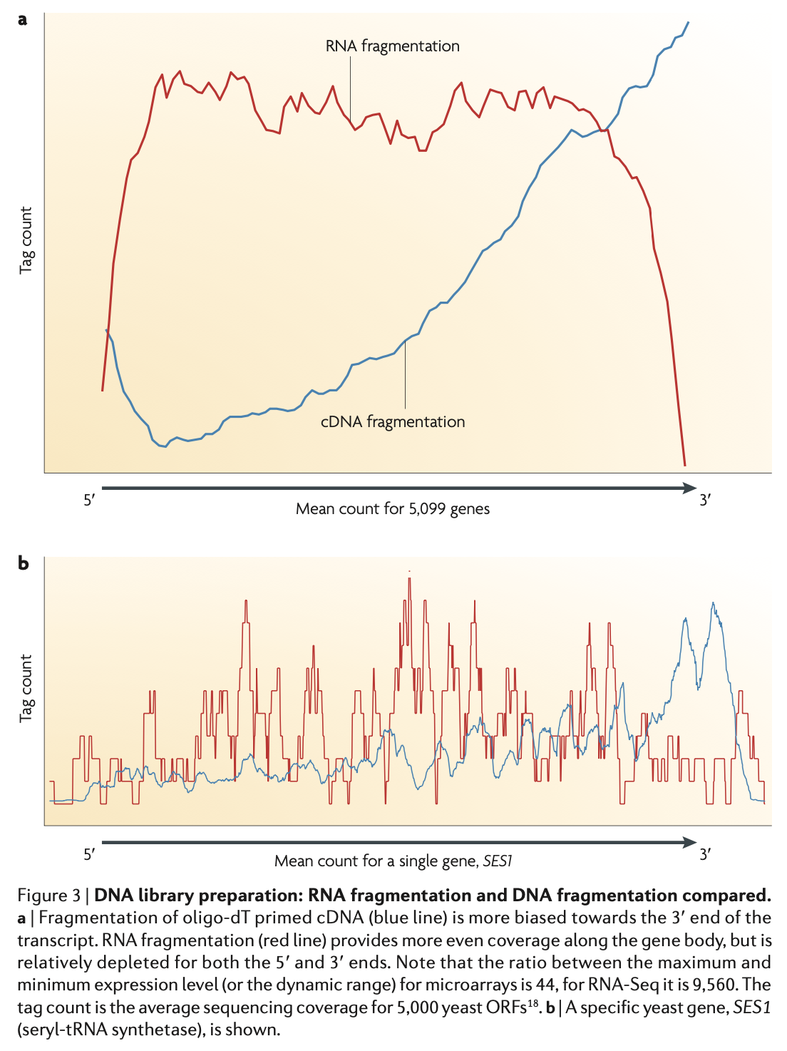
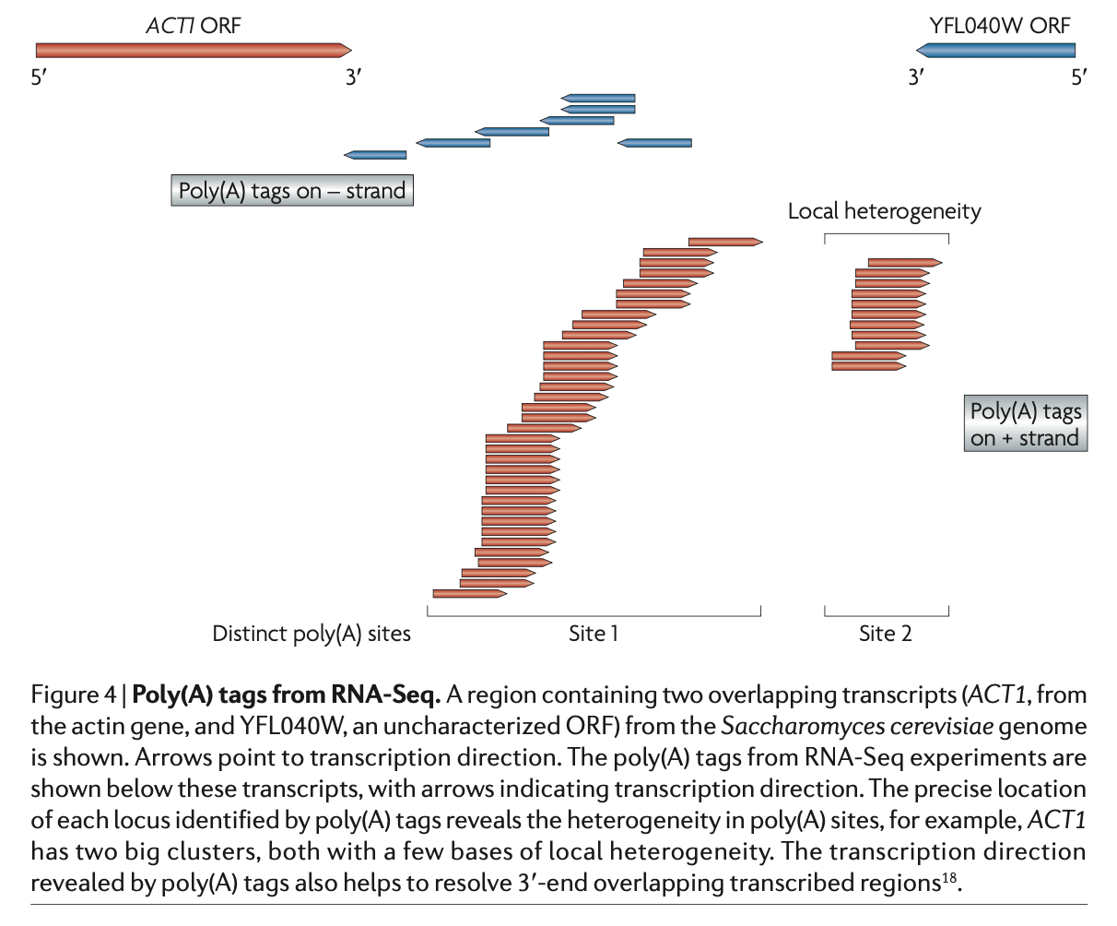
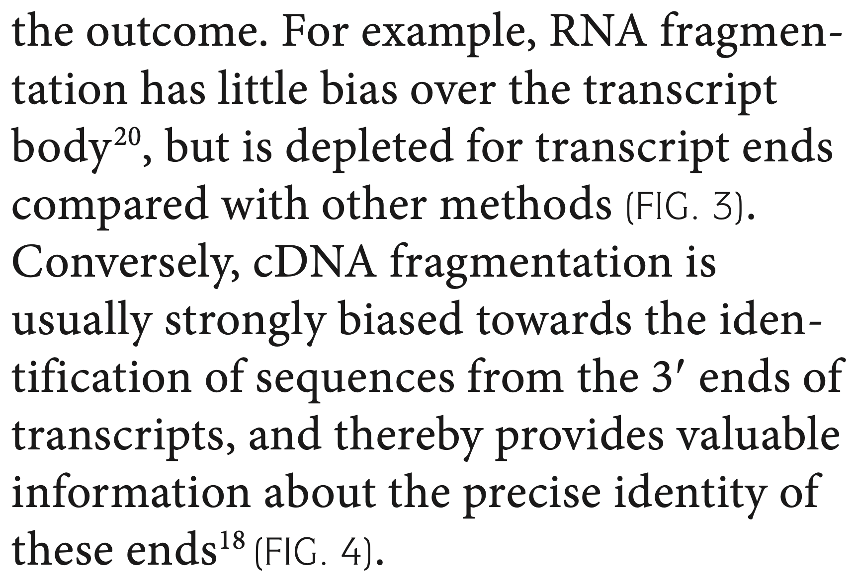
Challenges in Library Construction
Bias in fragmentation of RNA molecules

Slide 22
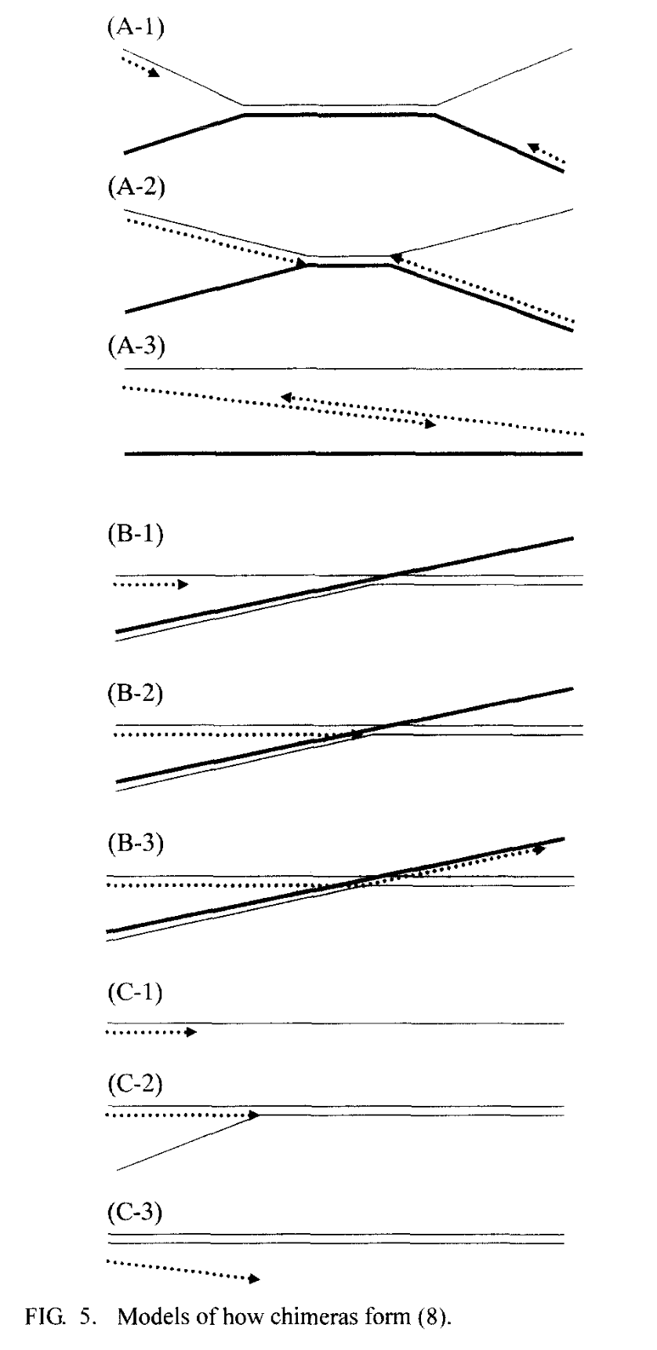
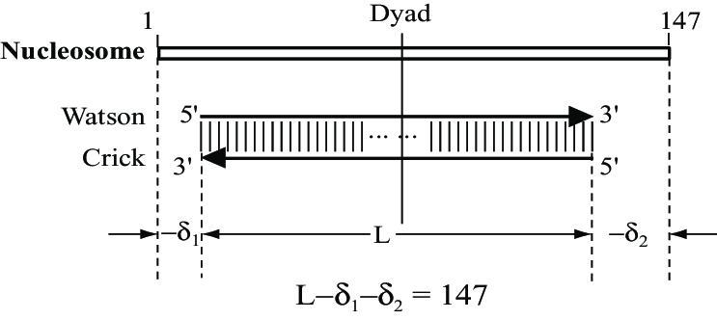
Challenges in Library Construction
Short reads might be results of PCR artifacts or genuine reflection of abundant RNA.
Difficulties in building the strand specific libraries.

Slide 23
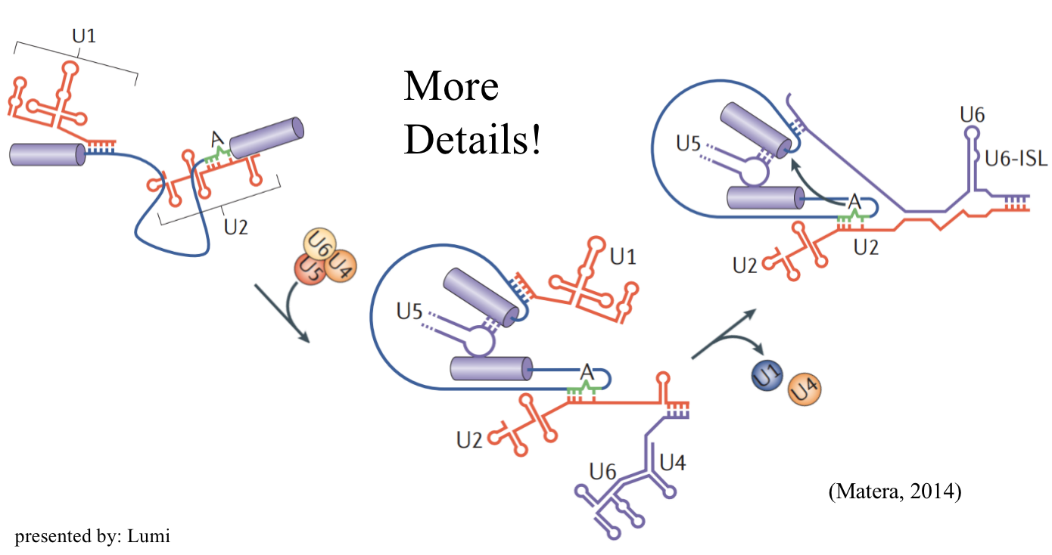
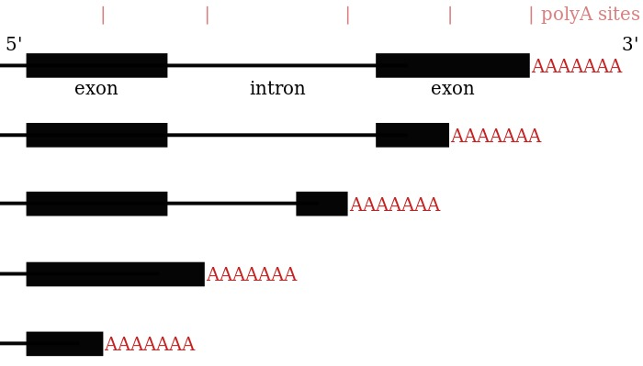
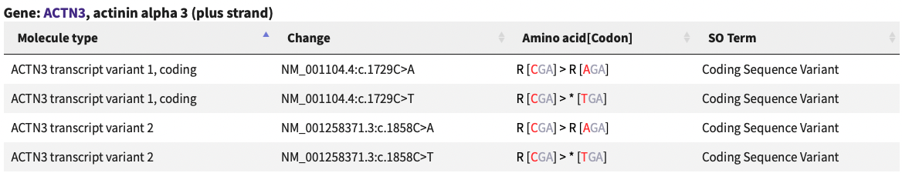
Challenges in Bioinformatics Analysis
Mapping RNA-seq data.

Slide 24
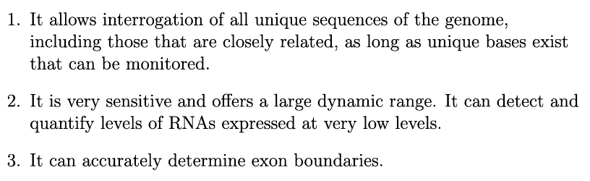
Advantages

Slide 25
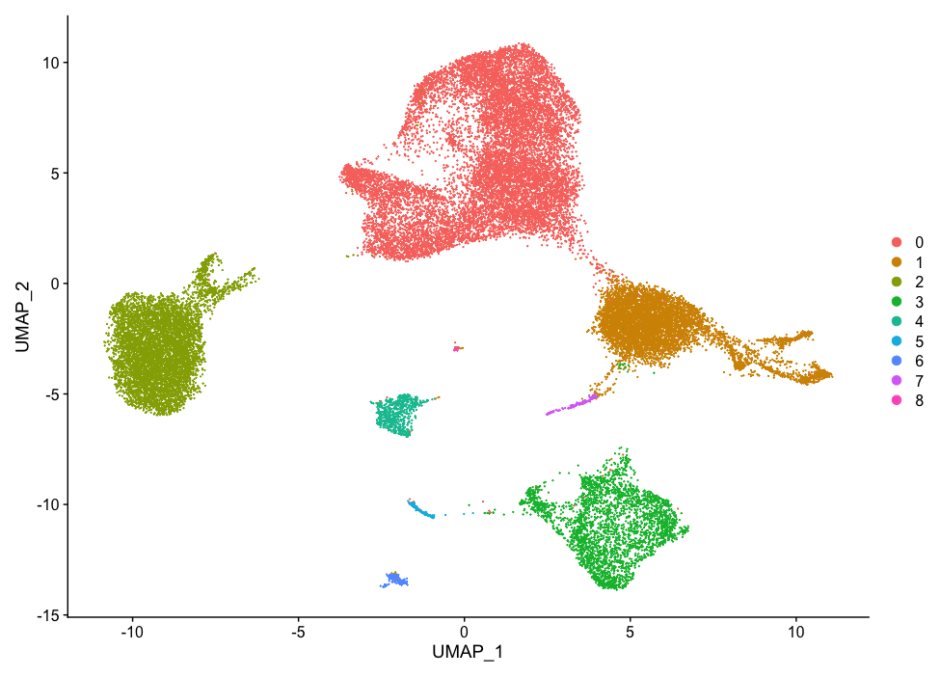
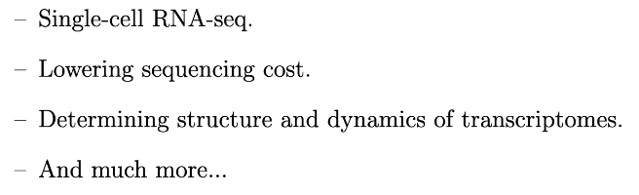
Futures

Slide 26
References
Kanagawa, T. (2003). Bias and Artifacts in Multitemplate Polymerase Chain Reactions (PCR). Journal of Bioscience and Bioengineering, 94, 4, 317-323. doi: 10.1016/S1389- 1723(03)90130-7
Nagalakshmi, U. et al. (2008). The Transcriptional Landscape of the Yeast Genome Defined by RNA sequencing. Science. 320. 1344-1349. doi: 10.1126/science.1158441
Shchelochkov, O, A. (2022). Open reading frame. National Human Genome Research Institute. Retrieved from: https://www.genome.gov/genetics-glossary/Open-Reading-Frame
Trevino, V. (2007). DNA Microarrays: a Powerful Tool for Biomedical and Clinical Research. Molecular Medicine, 13, 527–541. doi: 10.2119/2006-00107.Trevino
Zhong, W. Gerstein, M. & Snyder, M. (2009). RNA-Seq: a revolutionary tool for transcriptomics.
Nature Review Genetics, 10, 57-63. doi: doi.org/10.1038/nrg2484

Slide 27
About the Journal Club
Journal:
Methods in experiments.
Things of your interest.
Critical Thinking!
Respect
Procedures:
Background
The article (methods and results)
Your critics
Discussion

